Slide 1



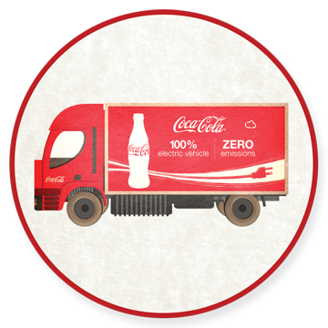
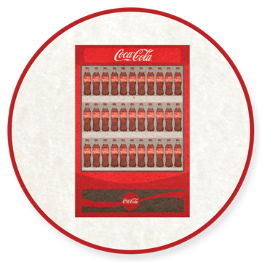


CLIMATE AMBASSADOR TRAINING:
EMISSIONS AND OUR BUSINESS
in partnership with
Notes:
Before we advance to learning about Coca-Cola’s climate goals, business case, and key interventions, this course provides a basic review of climate science. Many of you already know a lot about emissions science, greenhouse gases (GHGs), and climate science. In fact, you may be an expert in your Group on these topics; but even experts often lack a good understanding about how to express the key concepts of climate science in simple, non-controversial ways.
While you will not need to talk about climate science very often, you should be prepared to talk about how emissions relate to the Coca-Cola business. Keeping your conversations about carbon and climate change directly linked to the business is important.
This course reviews:
Basic science
Climate accounting
Carbon along the value chain
QUESTION to CONSIDER
How do you explain climate change now?

Slide 2

HOW DOES OUR BUSINESS CONNECT
WITH THE ATMOSPHERE?
The atmosphere has natural supply of (GHGs).
greenhouse gases.
GHGs capture heat from Earth’s surface, keeping it warm enough for life.
Photo credit: NASA
Notes:
Learning about the science is a critical first step in understanding how our business connects with the atmosphere.
The atmosphere has a natural supply of greenhouse gases (GHGs).

These gases are called “greenhouse gases” because GHGs capture heat radiated from the Earth’s surface and keep them inside the atmosphere. Just like a ‘greenhouse’ captures heat inside for plants to grow, GHGs in the atmosphere keep the Earth warm enough for us to live on.
GHGs are like a warm, insulating blanket, protecting us from the very cold “outer space”!

Slide 3

THE GREENHOUSE EFFECT
IS A GOOD THING
Because Mars has almost no greenhouse gases, heat from the sun goes back into outer space. -80 °F / -60 °C
Mars photo credit: NASA
Notes:
Greenhouse gases in Earth’s atmosphere are a good thing. Without them, there would be no life as we know it on Earth. A planet like Mars – which has almost no greenhouse gases – cannot hold heat. The heat from the sun goes back into outer space instead of being captured by the gases. Without a "thermal blanket," of greenhouse gases, Mars can't retain any heat energy.

That means, on average, the temperature on Mars is about minus 80 degrees F (minus 60 degrees C). In winter, near the poles temperatures can get down to minus 195 degrees F (minus 125 degrees C). A summer day on Mars may get up to 70 degrees F (20 degrees C) near the equator, but at night the temperature can plummet to about minus 100 degrees F (minus 73 C). Frost forms on the rocks at night, but as dawn approaches and the air gets warmer, the frost turns to vapor, and there is 100 percent humidity until it evaporates. Mars's atmosphere is about 100 times thinner than Earth's.
The bottom line: Mars has a very thin GHG blanket on it.
Of course, if you keep piling on the blankets… you get hotter.
As we add GHGs to the atmosphere, it’s like adding another blanket onto our natural blanket.

Slide 4
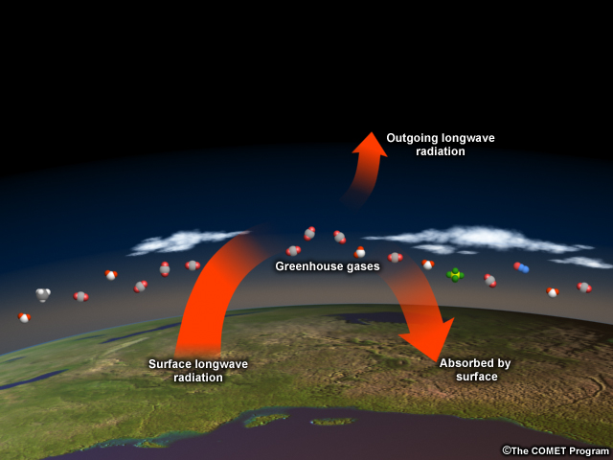
HOW DOES IT ALL WORK?
Notes:
So, back to the earth: what do greenhouse gases do?
Earth’s surface absorbs heat from the sun and then re-radiates it back into the atmosphere and to space. Though less than a 1% of atmospheric gases (21% is Oxygen and 78% is Nitrogen) are greenhouse gases, they are extremely powerful heat trappers. And 30% of this heat that is re-radiated out from Earth is absorbed by greenhouse gases. These gases serve like a thermal blank, capturing heat in the atmosphere and sending it back to the surface, to other greenhouse gas molecules, or out to space.
Over the past 300 years people started emitting a lot more greenhouse gases, so they are accumulating beyond what is normal for earth’s atmosphere.
How do we emit GHGs?
GHGs are emitted in many ways.
One of the primary ways is when fossil fuels are burned. Carbon – which was captured in the form of coal, petroleum, trees and other materials – is released into the atmosphere when these fossil fuels are burned.
Carbon is also released from natural carbon sinks.
Each time GHGs and carbon are released, it is effectively like piling on more blankets, heating the planet.

Slide 5
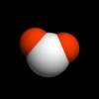
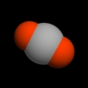


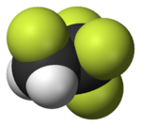

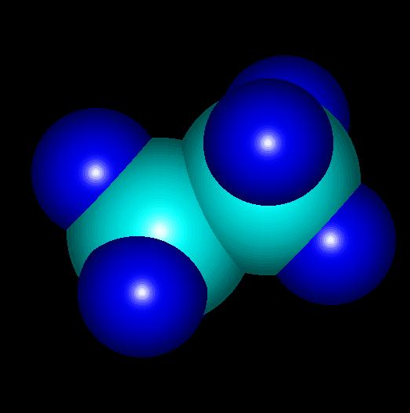
WHAT ARE THE
GREENHOUSE GASES (GHGs)?
Water
Nitrous Oxide
Carbon Dioxide
Methane
perfluorocarbons
Sulphur Hexafluoride
CO₂
HCFC-22
Water
Notes:
What are the GHGs? The 6 GHGs: CO₂, CH₄, N₂O, hydrofluorocarbons, perfluorocarbons and sulphur hexafluoride + H₂O
Four are the most important to us: Water, Nitrous Oxide, Carbon Dioxide, Methane.
Why?
Water vapor is the most abundant greenhouse gas. Its concentration is highly variable and human activity has little direct impact on its amount in the atmosphere.
Humans have most impact on CO₂, CH₄, N₂O.
Carbon Dioxide is the linear molecule consists of a carbon atom that is doubly bonded to two oxygen atoms.)
CO₂ accounts for 60% of total GHG forcing (extra heat absorbed in atmosphere as result of atmospheric composition changes relative to pre-industrial times).
Methane is the simplest of the various hydrocarbons and is the major hydrocarbon component of natural gas)
Methane is responsible for almost 1/5 of greenhouse effect (second in importance only to carbon dioxide).
Released into atmosphere from agriculture (rice, cattle and sheep), from landfills, biomass burning, mining and use of fossil fuels.
150% increase in methane since pre-industrial times.
1990s saw decline in methane in atmosphere from human activities but since 1999 has been on the rise. May increase in the future if tundra thaws, as it can be released from there.
Nitrous Oxide
Also known as: Laughing gas and Dinitrogen monoxide.
Used as an aerosol propellant
Comes from fertilizers
MORE INFORMATION IF INTERESTED
Sulphur hexafluoride
The main use of SF6 globally is in electricity transmission & distribution, which accounts for approximately 80% of use. These industries use SF6 for electrical insulation, arc quenching, & current interruption in equipment used in the transmission and distribution of electricity. Most of the SF6 used in electrical equipment is used in gas insulated switchgear (GIS) and circuit breakers, although some SF6 is used in high voltage gas-insulated transmission lines and other equipment.
Perfluorcarbons
Most emissions of PFCs in Australia are generated during aluminium production.
Better management of the aluminium smelting process and a production shift to smelters with lower PFC emission rates have resulted in a general decline in emissions.
The semiconductor industry is a relatively minor source and there are other small emissions from the refrigeration sector (leakage during operation and at the end-of-life destruction of equipment) and fire extinguishing systems.
PFCs have extremely high global warming potentials (5000 to 10,000 times that of carbon dioxide). However, because they are only released in relatively small amounts, their contribution to global warming is minor. Due to their stability they have very long atmospheric lifetimes (thousands of years).
Tetrafluoromethane also known as carbon tetrafluoride, Freon-14 and R 14
Tetrafluoromethane is sometimes used as a low temperature refrigerant. It is used in circuit board manufacture, manufacture of insulating materials and semiconductors. It is used as a gas etchant and dry/plasma etching.
Hexafluoroethane is used as a versatile etchant in semiconductor manufacturing. It can be used for selective etching of metal silicides and oxides versus their metal substrates and also for etching of silicon dioxide over silicon.
Together with trifluoromethane it is used in refrigerants R508A (61%) and R508B (54%).
Hydrofluorcarbons
They are composed entirely of carbon, hydrogen, and fluorine.
Major releases are from leakage from refrigeration equipment during operation and its end-of-life destruction.
Minor releases arise from the use of HFC-containing aerosols, air conditioners and metered dose inhalers.
There are no natural sources of releases to the environment.
HFCs have very high global warming potentials (100 to 3800 times that of carbon dioxide), however these are lower than the chlorofluorocarbons (CFCs) and HCFCs they replace. Due to their stability HFCs have fairly long atmospheric lifetimes (tens to hundreds of years).
Difluoromethane, also called HFC-32 or R-32, is a refrigerant that has zero ozone depletion potential.
1,1,1,2-Tetrafluoroethane, also called simply tetrafluoroethane, R-134a, Genetron 134a, Freon 134a or HFC-134a, is a haloalkane refrigerant without an ozone depletion potential.

Slide 6
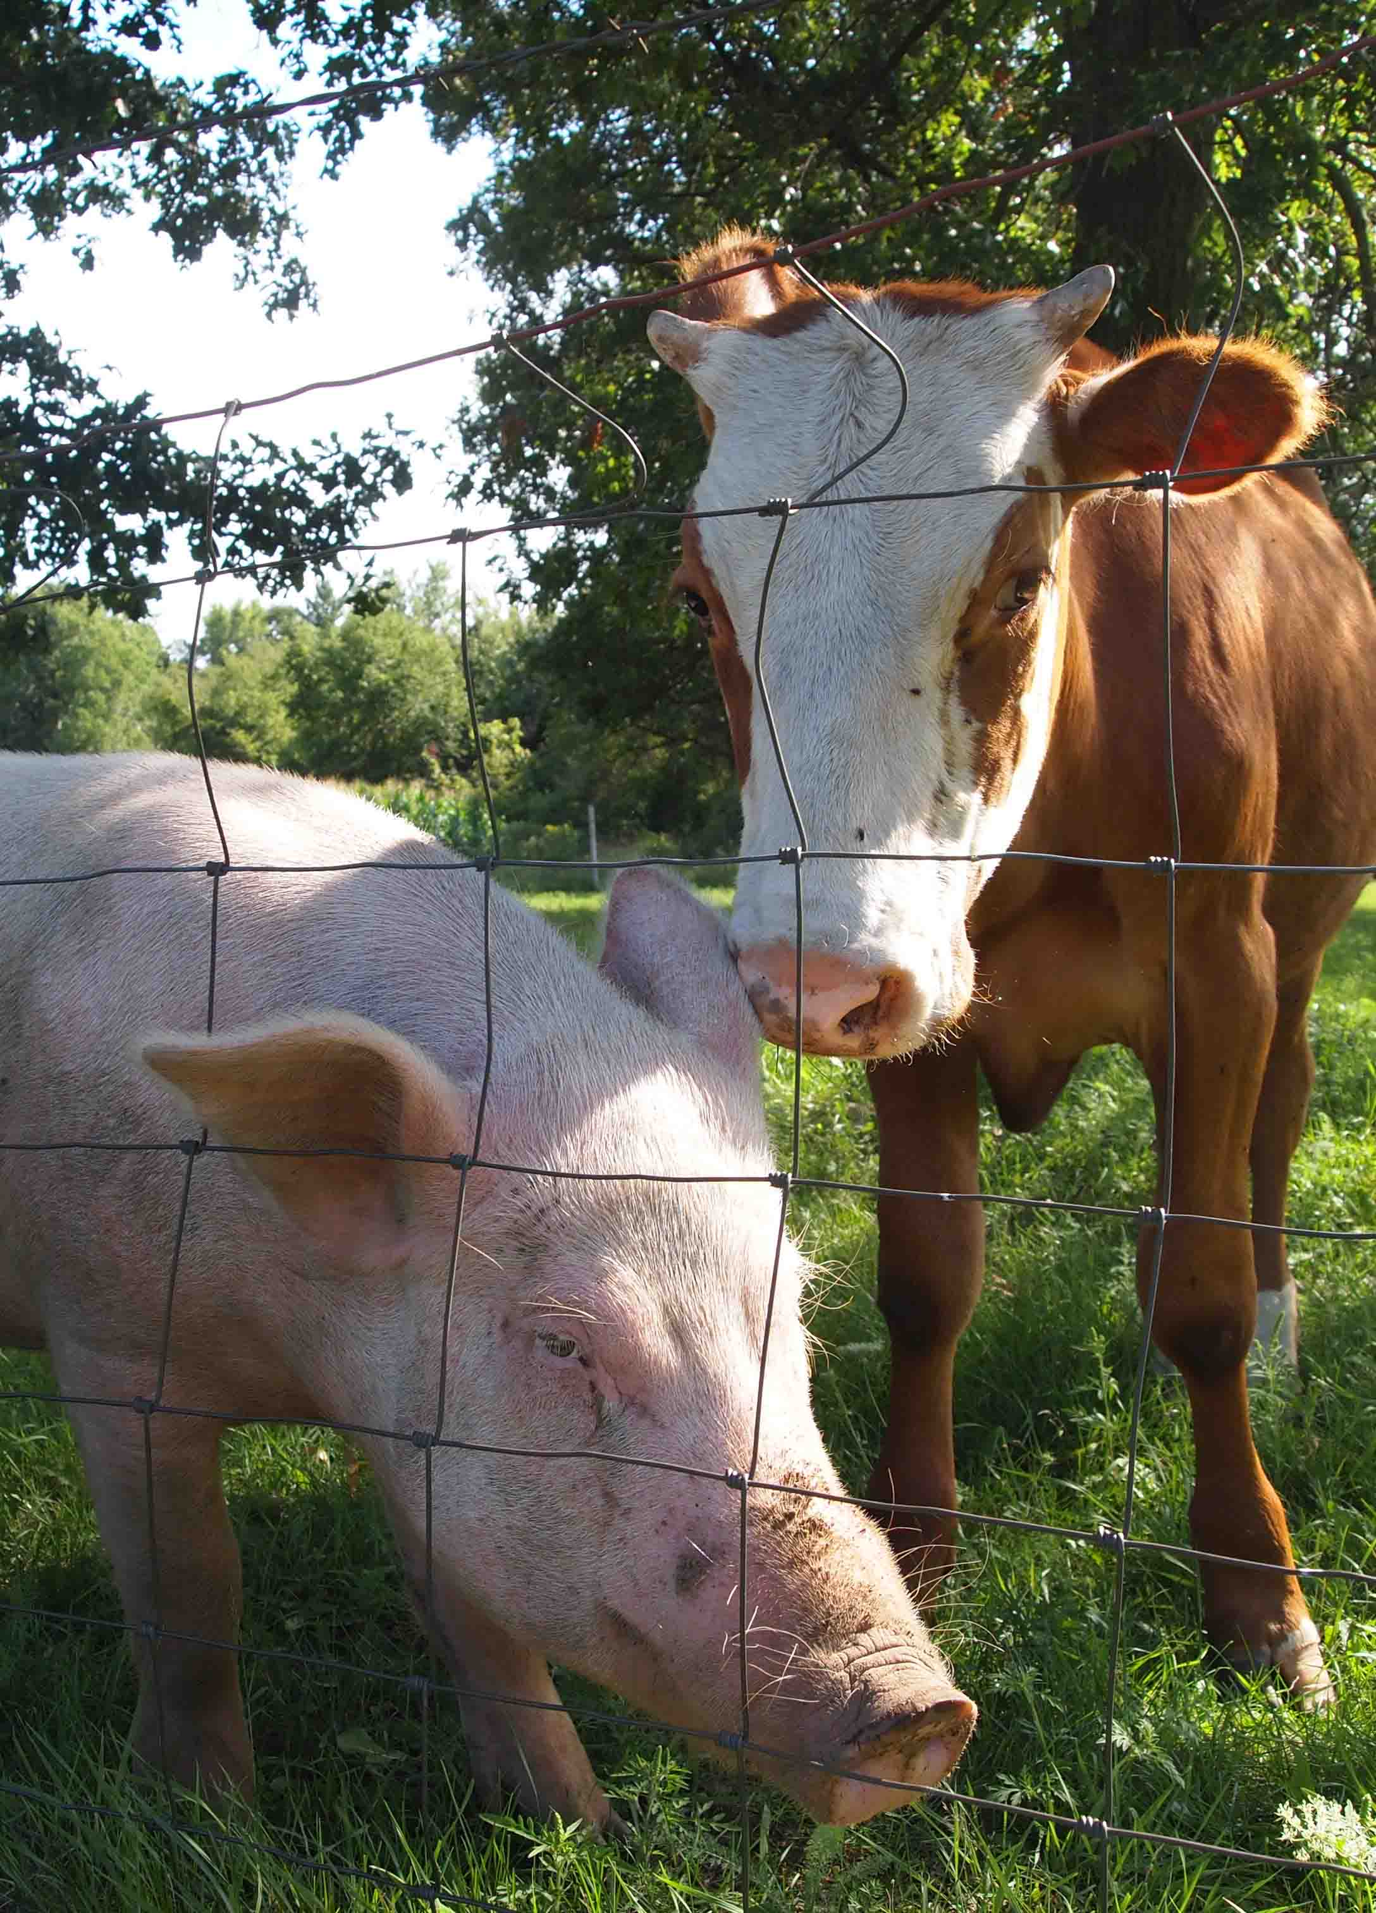
H₂O
N₂O
They come from unexpected places.
CH₄
CO₂
Water
Notes:
Earlier, the course mentioned where GHGs come from. GHGs also come from places we don’t normally consider.
WHY IS THERE A PIG AND A COW ON THE SCREEN?
Answer: That innocent picture likely has 4 of the listed GHGs shown.
Which ones?
Raising animals requires a great deal of water.
Farming the food for animals generally uses conventional fertilizers that release a lot of nitrous oxides
The pig and cow manure releases methane.
Animal husbandry uses machinery that has carbon dioxide.

Slide 7
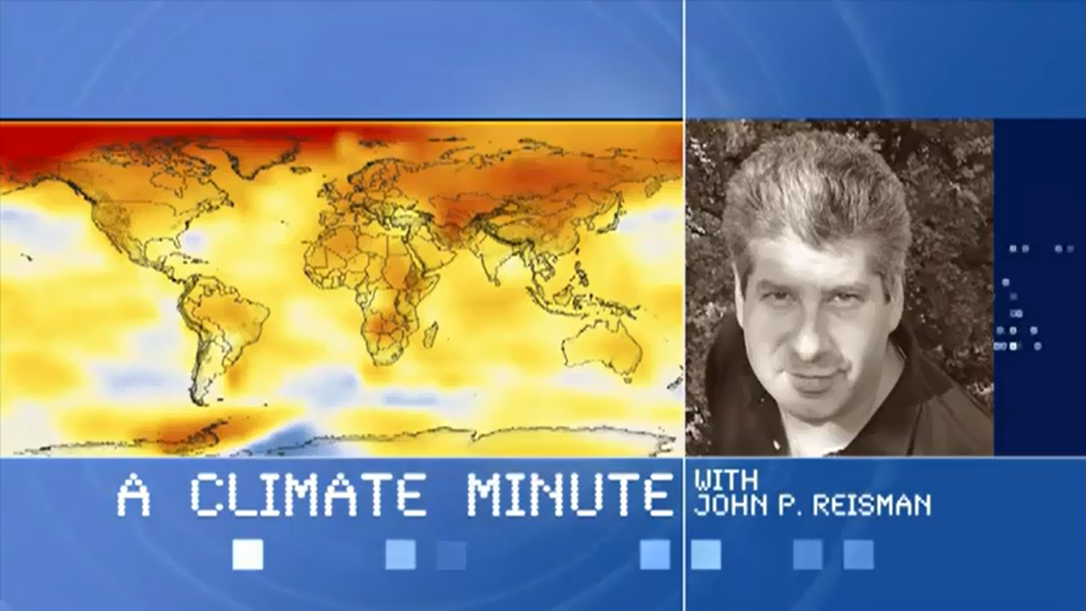
Notes:
This “Climate Minute” video gives a good visual description of what the course has covered.
http://www.youtube.com/watch?feature=player_embedded&v=ED2CB0ztTNM

Slide 8
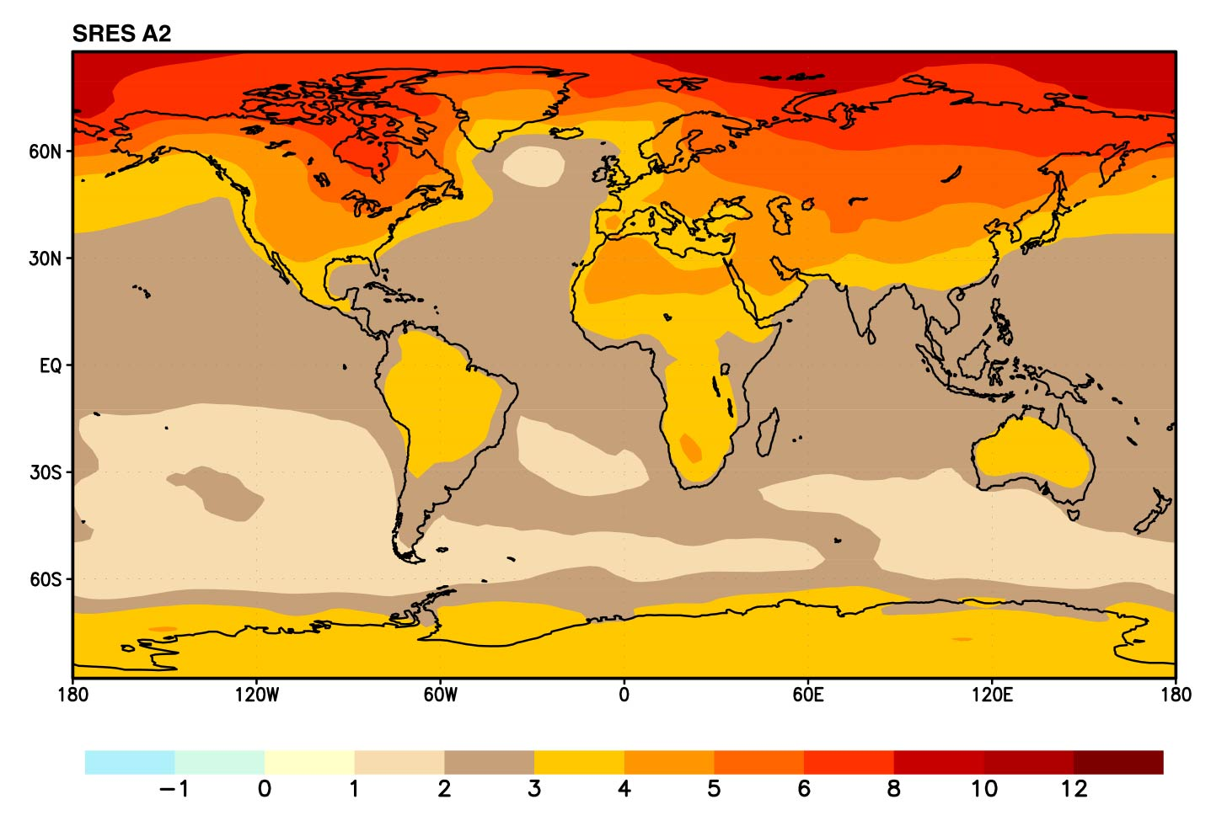
INCREASING GHG
THICKER BLANKET
ANNUAL MEAN TEMPERATURE in ~2070, RELATIVE TO 1990
Notes:
The more GHG, the thicker the blanket. As the blanket gets thicker, the Earth will experience shifts in climate zones.
This chart shows that SRES predicts how the annual mean temperature will change. The temperature shift shown is relative: showing the heat increase in the years 2071-2100, relative to 1990.
Look at how much hotter our farmlands and land masses will be. Some of you are looking at the map and looking forward to warmer winters?
These types of changes mean changes for our business. For example, these shifts in temperature also means shifts in our agricultural suppliers, water suppliers, and weather. For example, growing zones for many products may shift regions.
Note the predicted temperature difference where your plant/plants are.

Slide 9
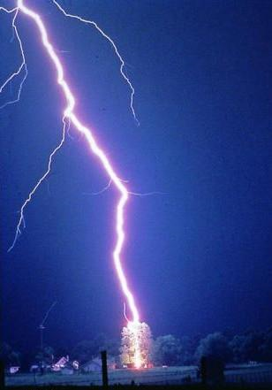
“But there are always changes in weather…”
Notes:
Someone is now wondering: “why attribute simple changes in weather events to climate change”?
So, it’s important to note the difference.
Weather: conditions of the atmosphere over a short period of time (winter, spring, summer, autumn, rain, sun, snow)
Climate: conditions of the atmosphere over long periods of time 30-year standard averaging period. (Glacial era, global warming)
Global Warming/Climate Change: is the increase of the Earth’s average surface temperature due to a build-up of greenhouse gases in the atmosphere.
Climate is what you expect, weather is what you get.

Slide 10

CLIMATE…
OR WEATHER?
CLIMATE CHANGE
(warming trend)
WEATHER VARIABILITY
(natural swings)
"climate"
SUM OF BOTH (We are seeing sum of both.)
Time (years)
Notes:
So are we seeing climate or weather variability? The data indicates that we are seeing both.
If you are interested in seeing graphs on global temperatures, you can view page 4 of this report by World Meteorological Organization, 2013. http://library.wmo.int/pmb_ged/wmo_1119_en.pdf

Slide 11

WHERE IS THE EVIDENCE?
TREES, FOSSILS, CHEMICALS
Tree ring analysis
Fossil evidence
Analysis of patterns and chemical composition in coral skeletons and ice cores
Notes:
Scientists learn about the past climate conditions from such things as tree ring analysis, fossil evidence, and analysis of patterns and chemical composition in coral skeletons and ice cores.

Slide 12
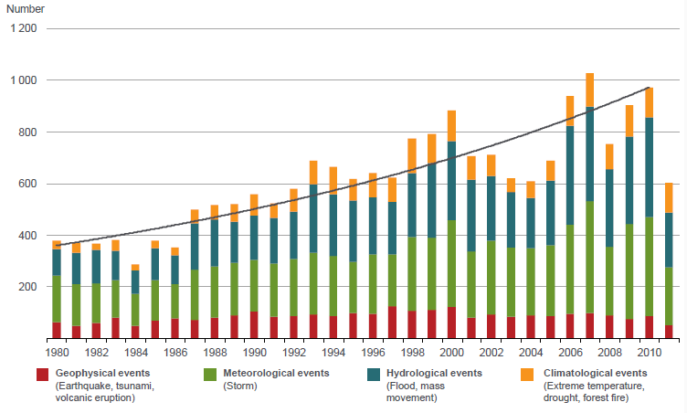
THE CHANGES OF WARMING
ARE UPON US…
Graph copyrighted by and courtesy of: Munich RE and Munchener Ruckversicherungs-Gesellschaft, Geo Risks Research, NatCatSERVICE
Notes:
We can already see the changes are upon us. One of the world’s more substantial insurance/reinsurance firms MunichRE has one of the largest databases of adverse weather events. They’ve been tracking for 30 years. And what they show is a steady increase in hydrologic (floods, mass movement), represented in blue, and climatologic events (extreme temperature, droughts, and forest fires), represented in orange.
Don’t get excited by the lower graph after 2010. Focus on the orange and blue.
12

Slide 13
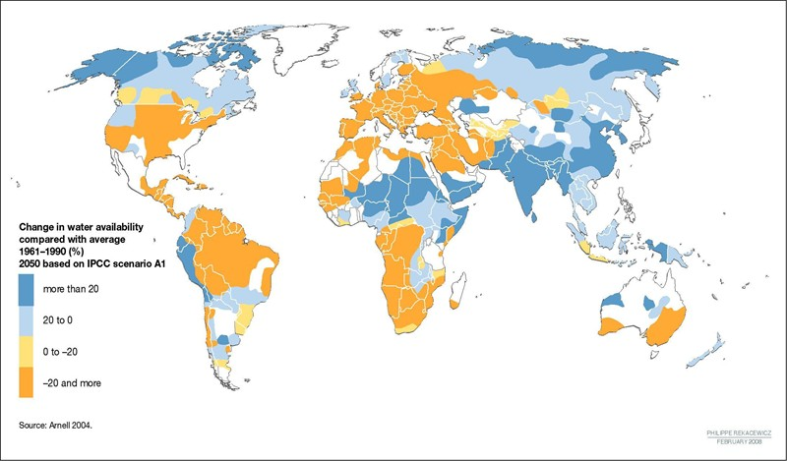
CONCERNING TO THE BUSINESS
EFFECT ON WATER
Image courtesy of GRID-ARENDAL
Notes:
In addition to what’s already happening, warming threatens big impacts on our water availability, which signifies risk for our core ingredient - water. This image from GRID ARENDAL* shows the change in water availability in 2050.
EXERCISE: NOTE WHERE YOUR PLANT IS. WHAT IS THE CHANGE?
WHO HAS THE BIGGEST CHANGE?
HOW DO YOU TALK ABOUT THIS IN YOUR BUSINESS?
None of good news for business.
GRID-Arendal is a center collaborating with the United Nations Environment Programme (UNEP), supporting informed decision making and awareness-raising through:
* Environmental information management and assessment * Capacity building services * Outreach and communication tools, methodologies and products

Slide 14
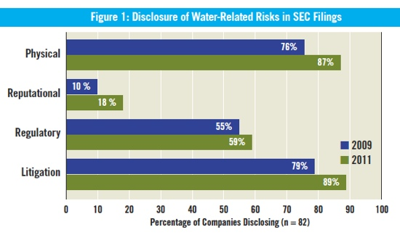
WATER RISK
INCREASING IN ALL INDUSTRIES…
Figure from CERES Clearing the Waters: A Review of Corporate Water Risk Disclosure in SEC Filings
Notes:
Many top consumer products companies are reacting to ‘climate change’ in their businesses. Those include Anheuser-Busch InBev, PepsiCo, KB Home, Alcoa and Intel. Companies disclosing water-related physical risks increased from 76 percent to 87 percent (see chart), according to the report. Oil and gas, and chemical companies’ reported exposure to physical water risks jumped to 31 percent and 45 percent, respectively. Additionally, the study found a 46 percent increase in the number of food companies reporting exposure to water-related risks.
Twenty-seven percent of companies assessed in CERES Clearing the Waters: A Review of Corporate Water Risk Disclosure in SEC Filings made the between climate change and water risk in 2011, up from 10 percent in 2009, according to a report from Ceres.
Of the 11 food companies evaluated, Archer Daniels Midland, Bunge, PepsiCo and Smithfield were the ones with water-related supply chain risk disclosures that mentioned specific agricultural commodities or regions facing water risk, or discussed climate-change impacts on their supply chains.
14

Slide 15

HOW DOES THIS RELATE TO THE BUSINESS?
Notes:
You have seen the basics of climate science. That information is important for you to understand in simple terms. There is also occasional dissension on the theme; that’s okay. While 97% of scientists concur about what you’ve learned, nothing in science is 100% certain.
What is certain is that Coca-Cola has made a commitment to reduce our carbon emissions by 25% of the drink in your hand by 2020; and the rest of this content helps understand how GHGs are measured to keep on track for goals.

Slide 16
WHY CARBON
WHAT HAPPENED TO ALL THE REST OF THE GHGs?
co₂e
Equivalent
Carbon dioxide (CO₂) 1
Methane (CH₄) 23
Nitrous oxide (N₂O) 296
Hydroflurocarbons (HFCs) 120-12,000
Perfluorocarbons (PFC) 5,700-11900
Sulfur hexafluoride (SF₆) 22,200
=
Notes:
Why does the Coca-Cola goal and much of this presentation reference “carbon” when we just learned that there are many GHGs?
 The international standard measuring GHGs is known as ‘carbon equivalency’ - or Equivalent Carbon Dioxide - CO₂e. All the gases are given a measurement that is ‘equivalent’ in terms of carbon, so that tracking and measurement is all based upon a common unit - ‘carbon’. Using a standard measurement makes universal tracking and measurement much easier.
This is very important because you’ll often hear “carbon accounting” and “carbon reduction”, but that most often refers to all GHGs.
Looking deeper, the ‘e’ signifies that we use the functionally equivalent amount or concentration of carbon dioxide for calculating how much global warming effect the other GHGs contribute.
Carbon dioxide (CO₂) 1
Methane (CH₄) 23
Nitrous oxide (N₂O) 296
Hydroflurocarbons (HFCs) 120-12,000
Perfluorocarbons (PFC) 5,700-11900
Sulfur hexafluoride (SF₆) 22,200

Slide 17
WHY CARBON ACCOUNTING
WHAT DOES MEASUREMENT LOOK LIKE?
co₂e
Carbon Equivalent (CO₂e) = Weight of the gas x Global Warming Potential
CO₂e expresses the amount of greenhouse gas in terms of the amount of carbon dioxide (CO₂) that would have the same global warming potential
E.g. 1 kg of CH₄ = 1 kg CH₄ * 23 = 23 kg CO₂e
CO₂e is useful has it expresses the amount of greenhouse gas emitted in a single figure.
Notes:
Looking at the concept of equivalency again as an equation:
Carbon Equivalent (CO₂e) = Weight of the gas x Global Warming Potential
CO₂e expresses the amount of greenhouse gas in terms of the amount of carbon dioxide (CO₂) that would have the same global warming potential
E.g. 1 kg of CH₄ = 1 kg CH₄ * 23 = 23 kg CO₂e
CO₂e is useful has it expresses the amount of greenhouse gas emitted in a single figure.

Slide 18

OUR CLIMATE ACTION TO DATE
(GHG PROTOCOL, SCOPES 1,2, LIMITED 3)
Notes:
None of us want yet another blanket, and we certainly want to take care of our water supplies and business (not to mention our families, health, and biodiversity), but aren’t we doing enough?
Coca-Cola and its bottling partners have worked together to reduce carbon in direct and indirect operations for many years. We have focused on our facilities mostly, and we have done good work there. But our goals are now more ambitious.

Slide 19

PRIOR FOCUS
MISSES BIG OPPORTUNITIES
INGREDIENTS
PACKAGING
MANUFACTURING
DISTRIBUTION
REFRIGERATION
CO₂e
13%
38%
9%
8%
32%
Notes:
Our prior focus on our own manufacturing and operations misses big opportunities
 like you see here in the average carbon breakdown along the supply chain.
We need to move beyond our own walls to our value chain.

Slide 20
EXPANDED
END-TO-END FOCUS
INGREDIENTS
PACKAGING
MANUFACTURING
DISTRIBUTION
REFRIGERATION
Sweeteners
Fruit, Tea,
Coffee, CO₂
Primary
Secondary
Fuel
Electricity
Trucking
Fleet
Logistics
Refrigerants
Electricity
Notes:
To meet our climate goal, we expanded our focus beyond the our operations to encompass our entire value chain.
INGREDIENTS
Starting with ingredients where we consider all of the products that go into our colas, teas, energy drinks, coffees, milks and other products.
PACKAGING
We’ll look at both primary (product packaging) and secondary packaging (aggregating, logistics, shipping, marketing packaging).
MANUFACTURING
We will continue our focus in becoming more energy efficient in our facilities and in tapping into positive renewable sources of energy.
DISTRIBUTION
Across our fleets and partner fleets, we’ll look at how to reduce emissions through fuel efficiencies, technologies, and behavior changes.
REFRIGERATION
And we’ll continue efforts to see a more efficient, environmentally-sound cold-chain.
You will learn more about this during your session with the Carbon Scenario Planner on Day 2 of the Climate Ambassador Training.
The last concept that this course covers is Carbon Accounting.

Slide 21
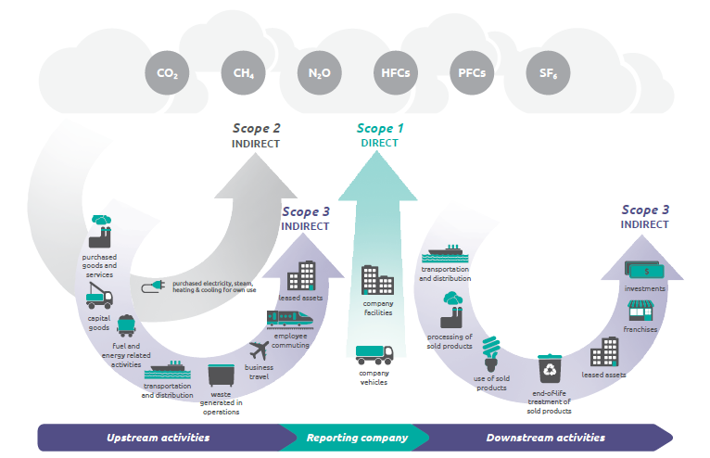
WHAT IS
CARBON ACCOUNTING?
Source: World Resources Institute (WRI) / World Business Council for Sustainable Development Corporate Value Chain (Scope 3) Accounting and Reporting Standard, Supplement to the GHG Protocol Corporate Accounting and Reporting Standard, Dec 2011
Notes:
We, of course, measure the work that we do to reduce carbon. We do so by following the global standard – the GHG Protocol – for accounting for carbon opportunity. (More information about the GHG Protocol can be found at: www.ghgprotocol.org).
The accounting of carbon emissions records, summarizes and reports the quantity of emissions as well as the carbon sequestered (or captured) by “sinks”, such as forests. Accounting looks at emissions and sequestering that are a direct result of human activities or natural processes that have been affected by human activities.
Emissions from human activities are commonly referred to as anthropogenic emissions.
GHG Protocol has set up accounting by ‘scopes’’: scope 1, 2, and 3. We review these scopes in this course, because you will hear about them regularly if you are engaged along our value chain in reducing carbon.
Scope 1 represents the direct effect on the facilities.
Scope 2 the indirect effect of business operations, your critical goods, your business travel, etc.
Scope 3 includes the activities of our supply chain: transportation and distribution, processing of products, use of sold products, end-of-life treatment of products, leased assets, franchises, investments. In our case, it will include everything from the farm to disposal. We can start to see carbon as the life of our product, from ingredient forward.
Examples from Scope 1
Optimize our Fleet facilities (use less fuel)
New fleet
Maintenance program
Alternative fuels
Logistics intelligence
Examples from Scope 2
Optimize our manufacturing facilities
Engineered solutions
CFL
Machinery
Light sensors
Behavious change
Awareness programs (training)
Performance incentives (carrot or stick)
Examples from Scope 3
Optimize our Supply Chain (Suppliers)
Ingredients
Packaging
Manufacturing (supplier facility)
Distribution (contracted fleet)
Refrigeration (cold chain)
Of course, this is not all as simple as it may appear. For example, refrigeration from our retailers is Scope 3, but when we own our refrigeration equipment, it might fall in Scope 1 or 2.
As expected of any accounting process, carbon accounting involves the use of spreadsheets and calculations.

Slide 22
HOW MUCH IS
A TON OF CARBON
8ft
8ft
512 ft.³
8ft
1 Ton
CO₂
Notes:
In volume it would fill a 8 X 8 X 8 room (512 ft3)
It is an odorless gas, and represents less than 1% of the gases in our atmosphere. However, it is vital to plants among other organisms.

Slide 23
STEPS IN ACCOUNTING
THE TON OF CARBON
Identify boundary/ies
Identify emission sources to be covered
Select an emissions calculation approach
Collect activity data and choose emission factors
Apply calculation tool to estimate emissions
Notes:
To give a strategic framework for how to approach accounting, viewing the steps can be helpful.
Identify boundary/ies
Identify emission sources to be covered
Select an emissions calculation approach
Collect activity data and choose emission factors
Apply calculation tool to estimate emissions
For Steps 2 to 3, there are many guidelines that can serve as a good reference. For example the, Intergovernmental Panel on Climate Change (IPCC) is especially design for national inventories.
The most complicated step complete is step number 4.
Step number 5 may somehow depend on the availability of step number 4.

Slide 24
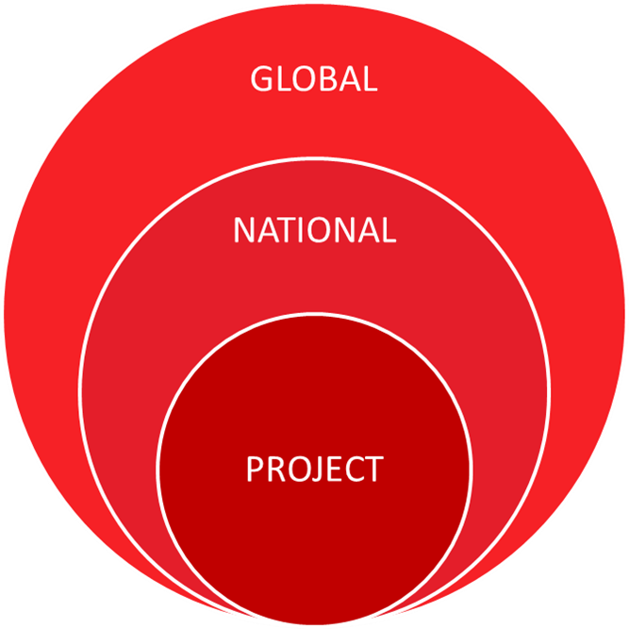
ACCOUNTING CONCEPT
IDENTIFYING BOUNDARIES (WHAT YOU WILL MEASURE)
Notes:
There are some key concepts that help in accounting:
Determining boundaries is important to understand where you start and stop measuring. There are different levels at which you might measure. For example, you might measure at the project level, at the geographical level, at the operational level, or even at a global company level. Coca-Cola’s goals is global across the system, and we’ll measure at all levels. There will be more focus on this concept when we review the Scenario Planner Tool.

Slide 25
ACCOUNTING CONCEPT
DIRECT, INDIRECT, ON-SITE, OFF-SITE
Direct emissions
emissions within project control, as a direct result of project intervention, e.g. waste heat utilization
Indirect emissions
outside project control, from changes in secondary energy carriers and materials as a result of project intervention, e.g. reduced import of heat supplied by an outside heating plant
On-site and Off-site emissions
in-and-out of project boundary
Notes:
Another key concept of carbon accounting is that of direct and indirect emissions.
Direct GHG emissions are emissions from sources that are owned or controlled by the reporting entity.
Indirect GHG emissions are emissions that are a consequence of the activities of the reporting entity, but occur at sources owned or controlled by another entity.
Scope 1: All direct GHG emissions.
Scope 2: Indirect GHG emissions from consumption of purchased electricity, heat or steam.
Scope 3: Other indirect emissions, such as the extraction and production of purchased materials and fuels, transport-related activities in vehicles not owned or controlled by the reporting entity, electricity-related activities (e.g. T&D losses) not covered in Scope 2, outsourced activities, waste disposal, etc.

Slide 26
ACCOUNTING CONCEPT
UPSTREAM, DOWNSTREAM, FULL-CYCLE
Upstream emissions
material impacts of activities that relate to the project activity but occur before it
Downstream emissions
material impacts of activities that relate to the project but occur after the project activity
Full cycle accounting
a comprehensive accounting of all the significant emissions related to a project
Notes:
Like the concept of direct and indirect emissions, is important to understand the concept of upstream and downstream, as you’ll hear it again and again in conversations about carbon accounting.
Upstream emissions
Scope 2
1. Purchased Electricity or Heat/Cooling
Scope 3
1. Purchased goods and services
2. Capital goods
3. Fuel- and energy-related activities (not included in scope 1 or scope 2)
4. Upstream transportation and distribution
5. Waste generated in operations
6. Business travel
7. Employee commuting
8. Upstream leased assets
Downstream emissions
Scope 3
9. Downstream transportation and distribution
10. Processing of sold products
11. Use of sold products
12. End-of-life treatment of sold products
13. Downstream leased assets
14. Franchises
15. Investments

Slide 27
HOW TO ACCOUNT
FOR CARBON REDUCTIONS
Business as usual:
baseline
Mt CO₂e emission
Reduced emissions
(Carbon Emission Reduction)
Project implemented
Start of project
End of project
years
Notes:
Carbon reduction accounts for the amount of deferred emissions due to an intervention as compared to the emissions from business as usual.
This deferred emission is calculated: GHG_{redn} = GHG_{base} – GHG_{proj} = emissions reduction due to existence of the project
GHG_{base} = an estimation of emissions assuming that no alternative project was implemented
GHG_{proj} = measures the GHG emissions following project implementation

Slide 28
CONSISTENCY IS CRITICAL
MEANINGFUL COMPARISON = OVER TIME
Production changes
Process changes
Acquisitions, mergers, sales
Outsourcing
Why is it important that GHG emissions be compared between different years?
Notes:
Consistency in accounting is very important. The GHG protocol states
Users of GHG information will want to track and compare GHG emissions information over time in order to identify trends and to assess the performance of the reporting company.
The consistent application of accounting approaches, inventory boundary, and calculation methodologies is essential to producing comparable GHG emissions data over time.
The GHG information for all operations within an organization’s inventory boundary needs to be compiled in a manner that ensures that the aggregate information is internally consistent and comparable over time.
If there are changes in the inventory boundary, methods, data or any other factors affecting emission estimates, they need to be transparently documented and justified.
 Why is it important that GHG emissions can be compared between different years?
To make meaningful statements about whether a company has reduced or increased emissions in absolute (i.e. total) or relative (i.e. normalized. e.g. per unit of production) terms, GHG emissions must be compared between years.

Slide 29
SELECT ADDITIONAL RESOURCES CLIMATE CHANGE + GREENHOUSE GAS PROTOCOL
Intergovernmental Panel on Climate Change - www.ippc.ch
World Business Council for Sustainable Development - www.Wbcsd.org
World Resources Institute – www.wri.org
Notes:
We’ve learned the basics of climate science and of carbon accounting, but there is much more to learn. For those interested, there are many resources available. These three resources are very well-respected internationally:
Intergovernmental Panel on Climate Change - www.ippc.ch
World Business Council for Sustainable Development - www.Wbcsd.org
World Resources Institute – www.wri.org

